Slide 1
Fundamentals of Data
Mining
— Week -—
Spring 2026
Dr. Hashim Safdar
11

Slide 2
Outline
Bayes Law
Spam Filter Design using Individual Word
Naïve Bayes
Spam Filter Design using Multiple Words
Comparison of Naïve Bayes and k-NN
2

Slide 3
Bayes Law
Concept:
Given events x and y, suppose y refer to the event “sick”; and
x refer to the event “the test is positive,” or “+”. Then
P (y | x) = P (x | y) . P (y) / P (x)
P(y | x) : Probability that patient is sick when the test is positive. (Posterior Probability of y)
P(y) : Probability that a person is sick before seeing the test result either +ve or -ve (Prior Probability of y)

Slide 4
Bayes Law
Concept:
P(x | y) : Probability that the test becomes positive when patient is actually sick (Posterior Probability of x)
P(x) : Overall probability of getting a positive test result (Prior Probability of x)
Various probabilities are
Prior Prob: P(sick) = 0.01 P(~sick) = 0.99
A sick person may test positive with 95% probability.
But a positive test does not always mean the person is definitely sick.
That is why Bayes law is needed.

Slide 5
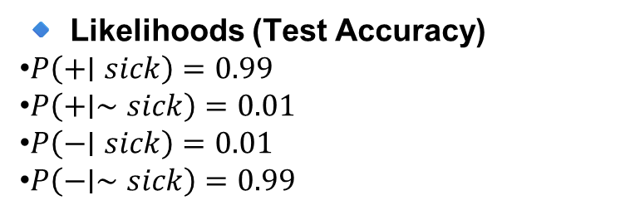
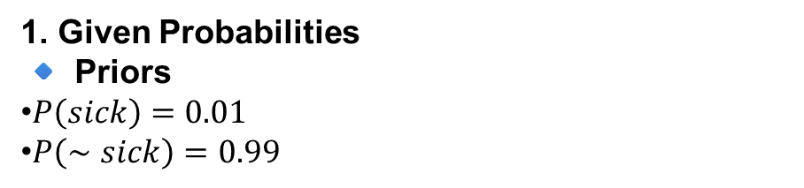
Bayes Law
Example:
Posterior Prob:
P(+|sick) = 0.99
P(+|~sick) = 0.01
P(-|sick) = 0.01
P(-|~sick) = 0.99
1. Given Probabilities
🔹 Priors
$P\left(sick\right)=0.01$
$P\left(∼sick\right)=0.99$
🔹 Likelihoods (Test Accuracy)
$P\left(+∣sick\right)=0.99$
$P\left(+∣∼sick\right)=0.01$
$P\left(−∣sick\right)=0.01$
$P\left(−∣∼sick\right)=0.99$

Slide 6
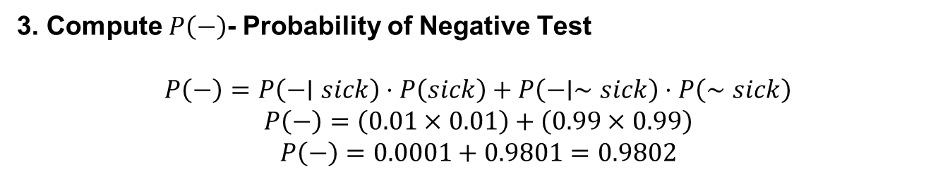
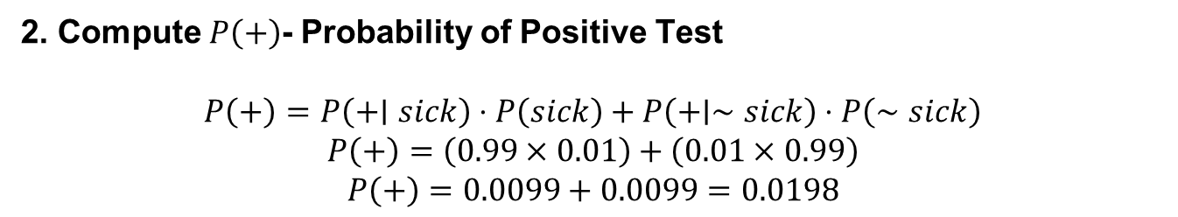
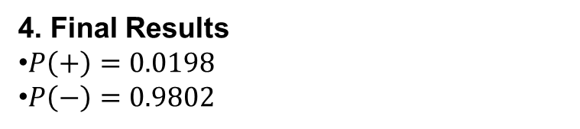
Bayes Law
2. Compute $P\left(+\right)$- Probability of Positive Test
$$P\left(+\right)=P\left(+∣sick\right)⋅P\left(sick\right)+P\left(+∣∼sick\right)⋅P\left(∼sick\right)$$
$$P\left(+\right)=\left(0.99×0.01\right)+\left(0.01×0.99\right)$$
$$P\left(+\right)=0.0099+0.0099=0.0198$$
Meaning: only about 1.98% people test positive.
3. Compute $P\left(−\right)$- Probability of Negative Test
$$P\left(−\right)=P\left(−∣sick\right)⋅P\left(sick\right)+P\left(−∣∼sick\right)⋅P\left(∼sick\right)$$
$$P\left(−\right)=\left(0.01×0.01\right)+\left(0.99×0.99\right)$$
$$P\left(−\right)=0.0001+0.9801=0.9802$$
Meaning: about 98% people test negative.
4. Final Results
$P\left(+\right)=0.0198$
$P\left(−\right)=0.9802$

Slide 7
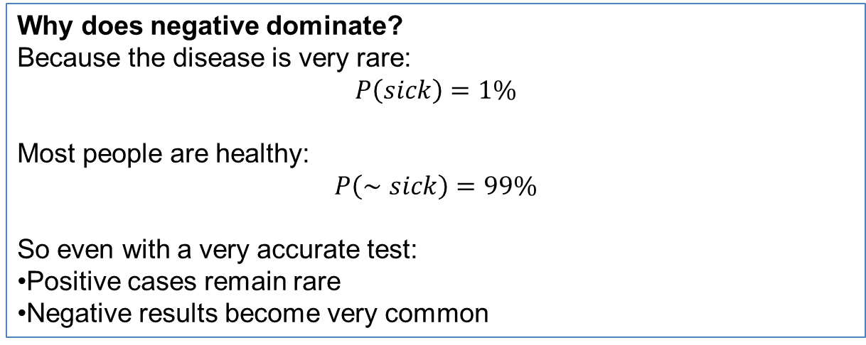
Bayes Law
Out of all people:
Only 1.98% test positive
About 98% test negative
Most people are not sick, so:
Negative results dominate
Positive results are rare
Why does negative dominate?
Because the disease is very rare:
$$P\left(sick\right)=1\%$$
Most people are healthy:
$$P\left(∼sick\right)=99\%$$
So even with a very accurate test:
Positive cases remain rare
Negative results become very common

Slide 8
A Spam Filter for Individual Words
How do we use Bayes’ Law to create a good spam filter?
If the word “Dating” appears, this adds to the probability that the email is spam. But it’s not conclusive, yet.
We need to see what else is in the email.
Let’s first focus on just one “word” at a time, Then, apply Bayes’ Law, we have:

Slide 9

A Spam Filter for Individual Words
What is the probability that the email is spam if this word appears?
If we refer to nonspam as “ham”. Then

Slide 10
A Spam Filter for Individual Words
Example
Suppose we have an employee’s email account.
Total emails are 5172: in which 1500 are spam emails and 3,672 are ham (not spam) emails.
Lets consider word “meeting”, whose count in spam emails are 16 and 153 in ham emails
Now compute the chance that an email is spam only knowing it contains the word “meeting”:

Slide 11
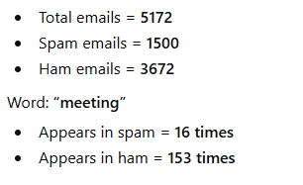
A Spam Filter for Individual Words

Slide 12
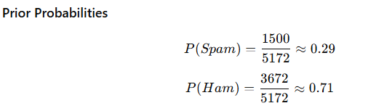
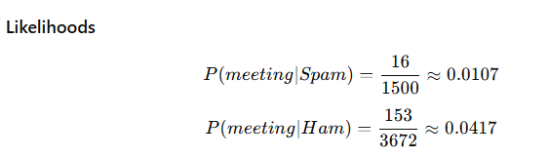
A Spam Filter for Individual Words

Slide 13
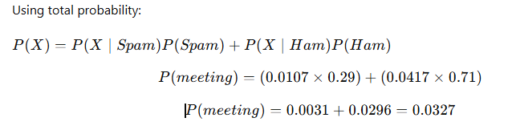
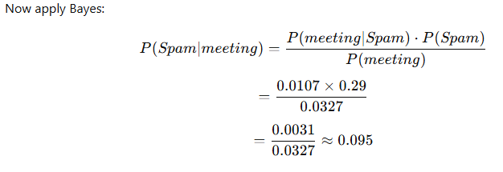

A Spam Filter for Individual Words
Compute Evidence $P\left(meeting\right)$
Compute Posterior Probability
$$P\left(Spam∣meeting\right)≈0.095≈9.5\%$$

Slide 14
A Spam Filter for Individual Words
Even if an email contains the word “meeting”:
Only 9.5% chance it is spam
So it is most likely NOT spam (ham)
“Not all words indicate spam. Some words like ‘meeting’ actually suggest normal emails.”

Slide 15
A Spam Filter for Individual Words
Next, we can try:
“money”: 80% chance of being spam
“Dating”: 100% chance
“enron”: 0% chance
This illustrates that the model, is overfitting; we are getting overconfident because of biased data.
Is it really a truth that any email containing the word “Dating” is spam?
It’s ofcourse possible to write a nonspam email with the word “Dating,” as well as a spam email with the word “Enron.”

Slide 16
Naïve Bayes
Naive Bayes is a probabilistic machine learning algorithm based on Bayes’ Theorem.
It is mainly used for classification problems such as spam detection, sentiment analysis, and medical diagnosis.
The word “naive” means it assumes that all features are independent of each other.

Slide 17
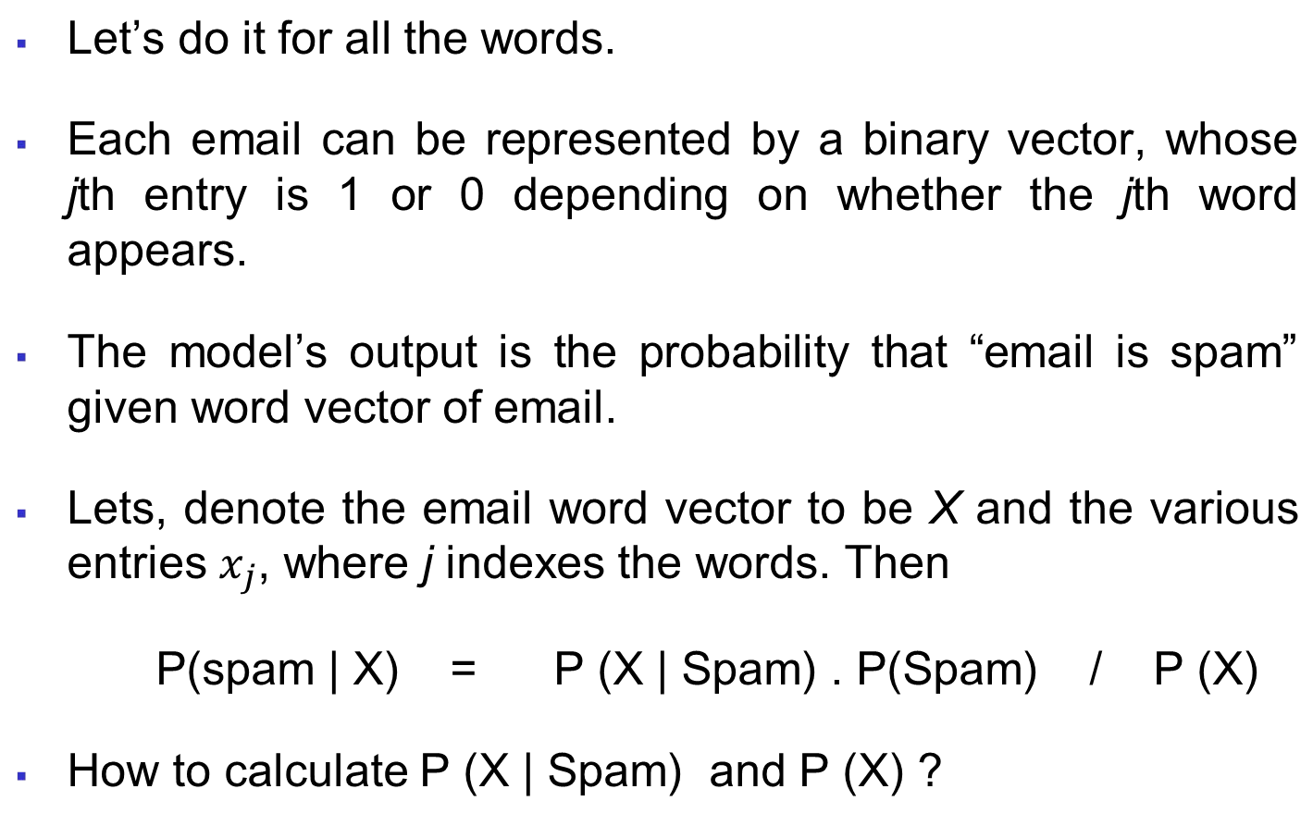
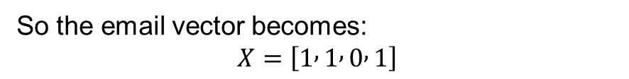
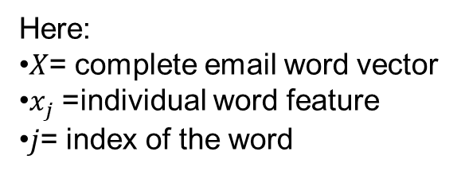
A Spam Filter That Combines Words: Naive Bayes
■
Word | Present?
Free | 1
Offer | 1
Meeting | 0
Prize | 1
So the email vector becomes:
$$X=\left[1 , 1 , 0 , 1\right]$$
Here:
$X$= complete email word vector
$x_{j}$= individual word feature
$j$= index of the word

Slide 18
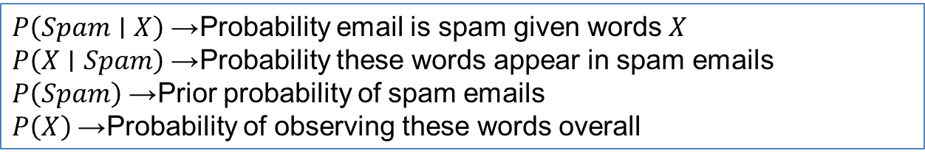
A Spam Filter That Combines Words: Naive Bayes
■
$P\left(Spam∣X\right)$→ Probability email is spam given words $X$
$P\left(X∣Spam\right)$→ Probability these words appear in spam emails $P\left(Spam\right)$→ Prior probability of spam emails
$P\left(X\right)$→ Probability of observing these words overall

Slide 19
A Spam Filter That Combines Words: Naive Bayes
Example:
A new sample email is given by
Email A
= < 1, 0, 1 >,
= < count(dating), count(meeting), count(enron)>
P(X∣Spam)=P(x1​∣Spam)×P(x2​∣Spam)×...
Instead of calculating one huge probability, we multiply probabilities of individual words.
How to calculate the probability of email A being spam?
P(Spam | X = x1, x2, x3) = P(X = x1, x2, x3 | spam) * P(spam)
/ P(X = x1, x2, x3)

Slide 20

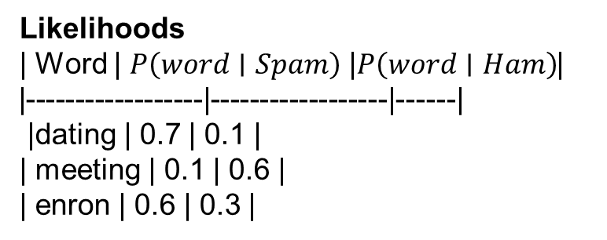
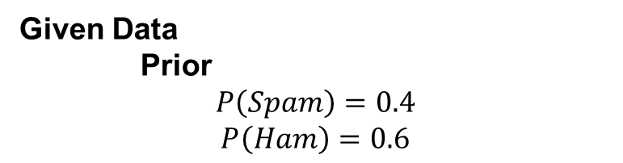
A Spam Filter That Combines Words: Naive Bayes
Example:
Given Data
Prior
$$P\left(Spam\right)=0.4$$
$$P\left(Ham\right)=0.6$$
Likelihoods
| Word | $P\left(word∣Spam\right)$| $P\left(word∣Ham\right)$| |------|------------------|------------------| | dating | 0.7 | 0.1 | | meeting | 0.1 | 0.6 | | enron | 0.6 | 0.3 |

Slide 21
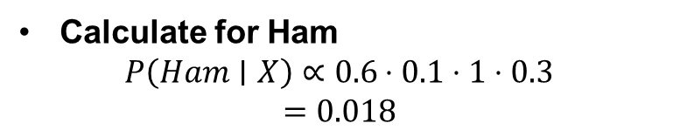
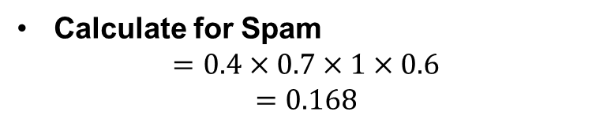
A Spam Filter That Combines Words: Naive Bayes
Example:
Calculate for Spam
$$=0.4×0.7×1×0.6$$
$$=0.168$$
Calculate for Ham
$$P\left(Ham∣X\right)∝0.6⋅0.1⋅1⋅0.3$$
$$=0.018$$
Compare
Spam = 0.168
Ham = 0.018
Email is classified as Spam

Slide 22
Comparing Naive Bayes and k-NN
Naive Bayes is a linear classifier, while k-NN is not.
The curse of dimensionality and large feature sets are the problems for k-NN, while Naive Bayes performs well.
k-NN requires no training (just load the dataset), whereas Naive Bayes does.
Both are examples of supervised learning

Slide 23
Any Question
22

